Slide 1

Chapter 16
Database Administration and Security
The slides in this presentation have been adapted from slides provided with the textbook, Database Systems: Design, Implementation, and Management,
12E, Cornel and Morris, Copyright © 2017 Cengage Learning.

Slide 2
Learning Objectives
That data are a valuable business asset requiring careful management
How a database plays a critical role in an organization
That the introduction of a DBMS has important technological, managerial, and cultural consequences for an organization
About the database administrator’s managerial and technical roles
Copyright © 2017 Cengage Learning
2

Slide 3
Data as a Corporate Asset
Data:
Valuable asset that requires careful management
Valuable resource that translates into information
Accurate, timely information triggers actions that enhance company’s position and generate wealth
Dirty data
Data that suffer from inaccuracies and inconsistencies
Threat to organizations
Copyright © 2017 Cengage Learning
3

Slide 4
Data as a Corporate Asset
Data quality
Comprehensive approach to ensuring the accuracy, validity, and timeliness of the data
Data profiling software
Consists of programs that gather statistics and analyze existing data sources
Master data management (MDM) software
Helps prevent dirty data by coordinating common data across multiple systems
Copyright © 2017 Cengage Learning
4

Slide 5
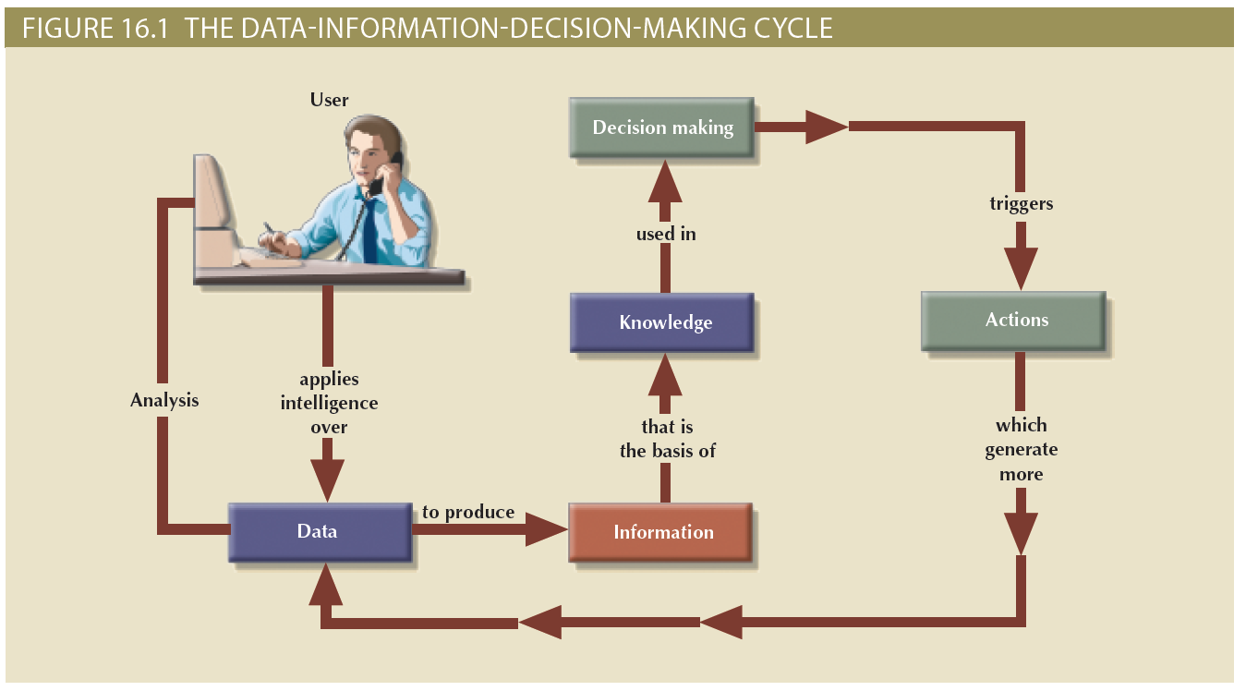
Copyright © 2017 Cengage Learning
5

Slide 6
Introduction of a Database
Technological aspect
Selecting, installing, configuring, and monitoring the DBMS to ensure that it operates efficiently
Managerial aspect
Careful planning to create an appropriate organizational structure
Cultural aspect
Listening to people’s concerns about the system and explaining its uses and benefits
Copyright © 2017 Cengage Learning
6

Slide 7
Evolution of the Database Administration Function
Information systems (IS) department
Provides end users with data management support and solutions for information needs
Database administrator
Responsible for control of the centralized and shared database
Systems administrator
General coordinator of all DBAs
Data administrator (DA) or information resource manager (IRM)
Has a higher degree of responsibility and authority than the DBA
Copyright © 2017 Cengage Learning
7

Slide 8
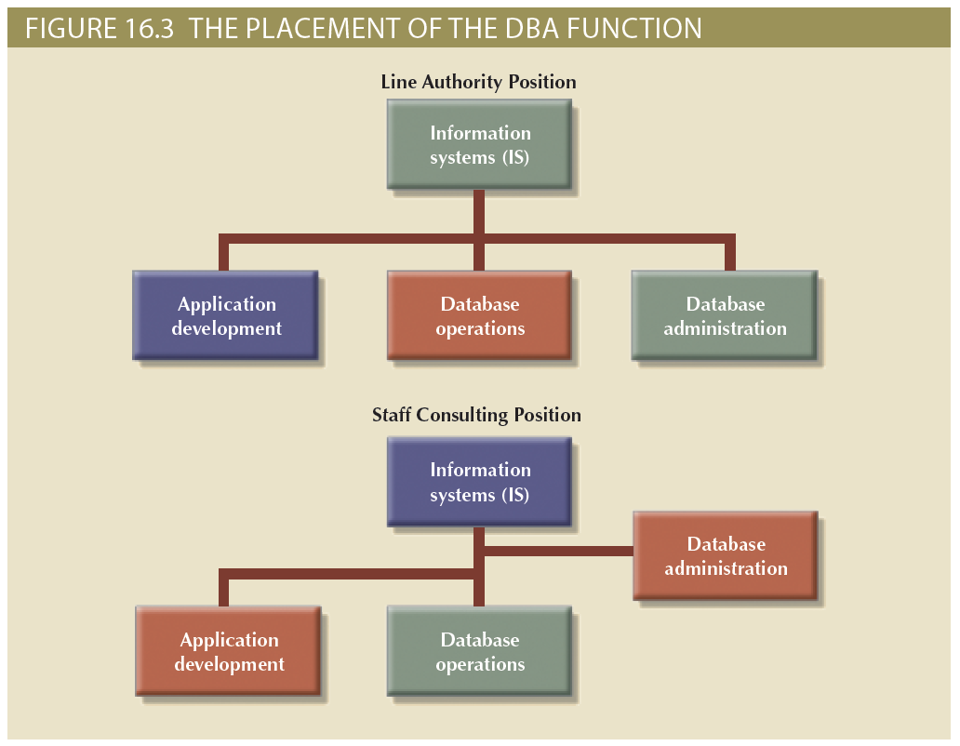
Copyright © 2017 Cengage Learning
8

Slide 9
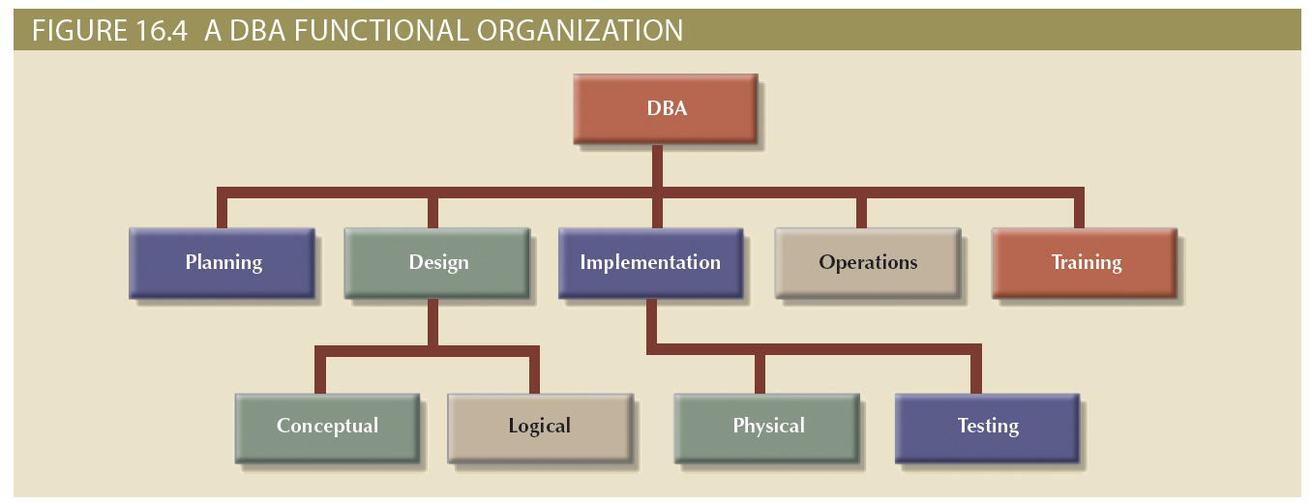
Figure 16.4 - A DBA Functional Organization
Copyright © 2017 Cengage Learning
9

Slide 10
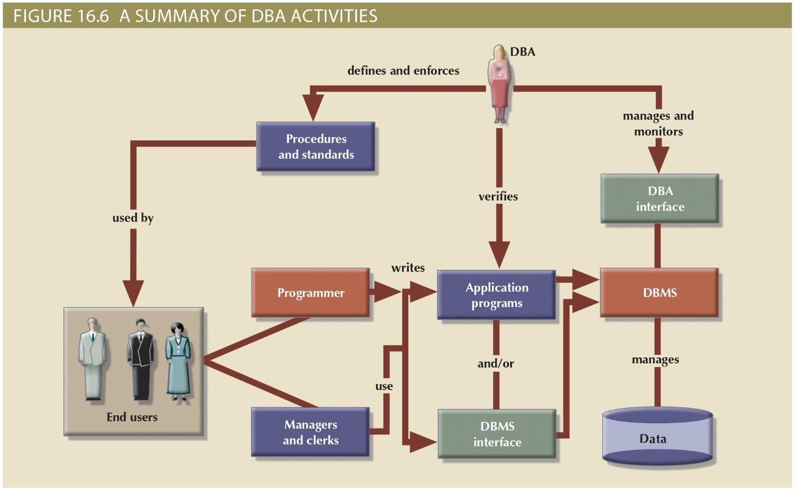
Copyright © 2017 Cengage Learning
10

Slide 11
DBA’s Managerial Role
Provide end-user support
Enforce policies, procedures, and standards for correct data creation, usage, and distribution within the database
Manage data security, privacy, and integrity
Manage data distribution and use
Copyright © 2017 Cengage Learning
11

Slide 12
DBA’s Managerial Role
Manage data backup and recovery
Fully recover data in case of data loss
Database security officer (DSO): Ensures database security and integrity
Disaster management: Planning, organizing, and testing of database contingency plans and recovery procedures
Full backup or database dump: Produces a complete copy of the entire database
Incremental backup: Produces a backup of all data since the last backup date
Concurrent backup: Takes place while the user is working on the database
Copyright © 2017 Cengage Learning
12

Slide 13
DBA’s Technical Role
Evaluate, select, and install DBMS and related utilities
Design and implement databases and applications
Test and evaluate databases and applications
Operate the DBMS, utilities, and applications
Train and support users
Maintain the DBMS, utilities, and applications
Copyright © 2017 Cengage Learning
13

Slide 14
DBA’s Role in the Cloud
Reduced role in installing and maintaining the DBMS as cloud services provide:
DBMS installation and updates
Server/network management
Backup and recovery operations
Copyright © 2017 Cengage Learning
14

Slide 15
Security Goals
Confidentiality: Protecting data against unauthorized access
Compliance: Activities that meet data privacy and security reporting guidelines
Integrity: Keeping data consistent and free of errors or anomalies
Availability: Accessibility of data whenever required by authorized users and for authorized purposes
Copyright © 2017 Cengage Learning
15

Slide 16
Security Policy
Collection of standards, policies, and procedures created to guarantee security
Ensures auditing and compliance
Security audit process
Identifies security vulnerabilities
Identifies measures to protect the system
Security audit process identifies security vulnerabilities
Identifies measures to protect the system
Copyright © 2017 Cengage Learning
16

Slide 17
Security Vulnerability
Weakness in a system component that could allow unauthorized access or cause service disruptions
Categories - Technical, managerial, cultural, and procedural
Security threat: Imminent security violation
Security breach: Occurs when a security threat is exploited and could lead to a database whose integrity is preserved or corrupted
Copyright © 2017 Cengage Learning
17

Slide 18
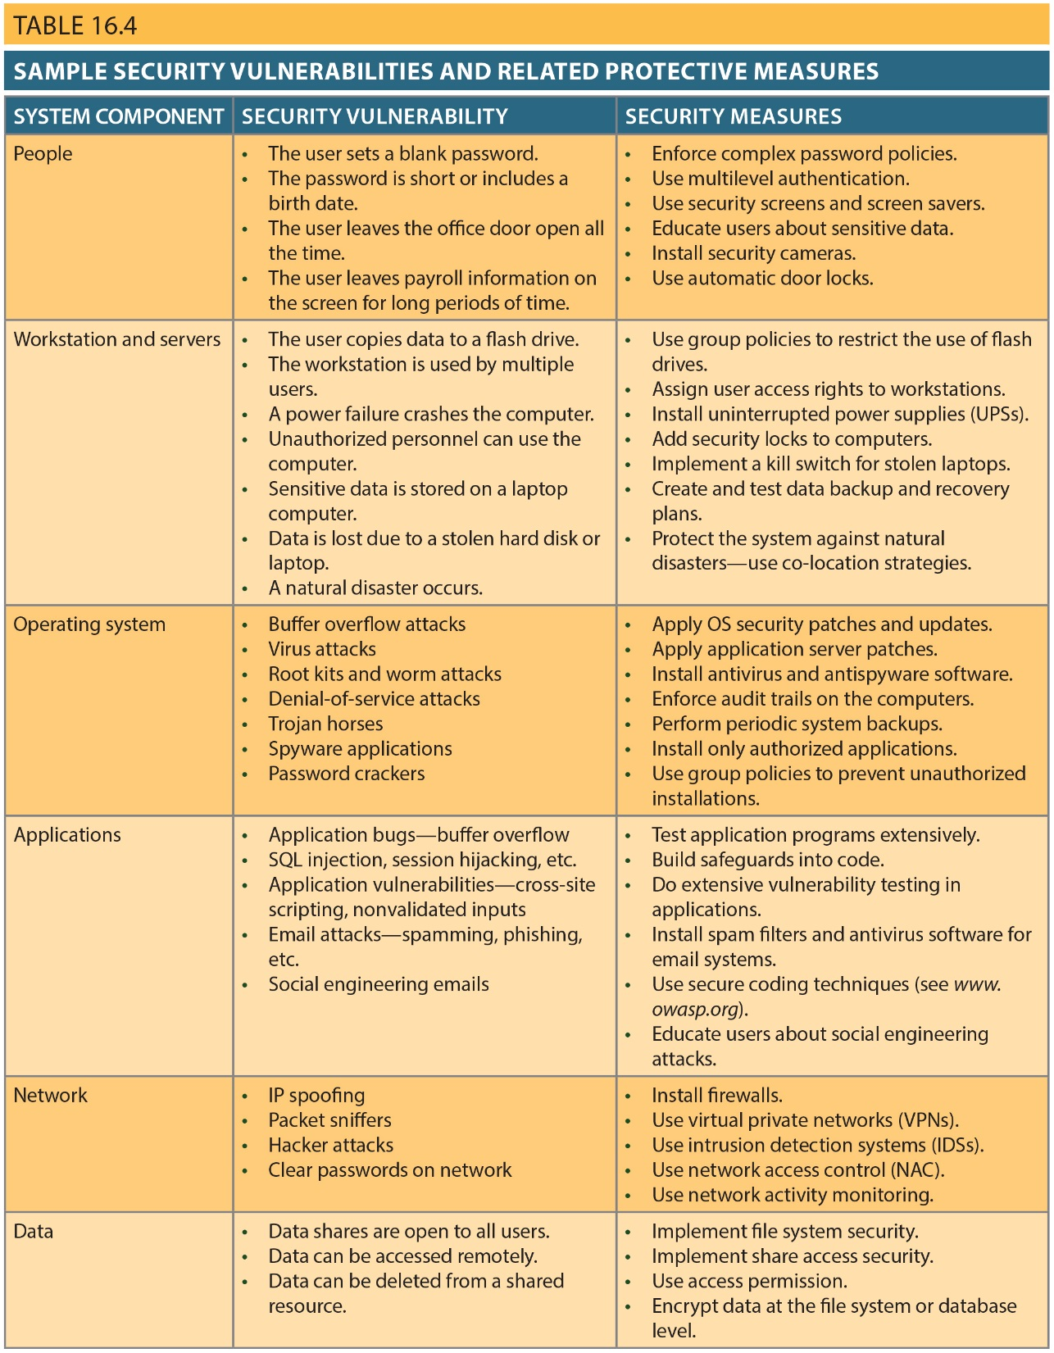
Copyright © 2017 Cengage Learning
18

Slide 19
Database Security
DBMS features and related measures that comply with the security requirements
Authorization management: Procedures to protect database security and integrity
User access management
View definition
DBMS access control
DBMS usage monitoring
Audit log: Automatically records description of database operations performed by all users
Copyright © 2017 Cengage Learning
19

Slide 20
Data Dictionary
Types
Integrated - Included with the DBMS
Standalone - Third-party systems
Active data dictionary: Automatically updated by the DBMS with every database access
Passive data dictionary: Requires running a batch process
Main function - Store description of all objects that interact with the database
Copyright © 2017 Cengage Learning
20

Slide 21
Data Dictionary or Information Resource Dictionary
Metadata is the basis for monitoring database use and for assigning access rights to users
DBA uses data dictionary to support data analysis and design
Copyright © 2017 Cengage Learning
21

Slide 22
Summary
Data management is a critical activity for any organization
Data should be treated as a corporate asset
DBMS is the most commonly used electronic tool for corporate data management
DBMS has impact on organization’s managerial, technological, and cultural framework
Data administration function evolved from centralized electronic data processing
Copyright © 2017 Cengage Learning
22

Slide 23
Summary (cont’d.)
Security: ensures confidentiality, integrity, availability of information system and data
Security policy: collection of standards, policies, and practices
Security vulnerability: weakness in system component
Copyright © 2017 Cengage Learning
23

Slide 24
Task
Explain why or why not data in a database should be encrypted.
Copyright © 2017 Cengage Learning
24

